Slide 1

Technical Writing and Presentation Skills

Slide 2

Types of Communication
Written:
Written communication involved any type of message that makes use of written word. It is the most important and effective of any mode of (professional) communication.
Oral:
Oral communication takes place in face-to-face conversations, group discussions, telephone calls and other circumstances in which spoken word is used to express meaning.

Slide 3
Written Documents Vs. Oral Presentation
Written Documents | Oral presentation
Publication permits potentially unlimited audience over time and place | Audience generally limited to time and place of delivery
No direct audience interaction. | High level of audience interaction
Refined argumentative structure. | Simple presentation of main points
Large volume of detailed information can be communicated | Limited information transfer
Precise syntax and diction. | Conversational syntax and diction
Emphasis on text | Emphasis on Visuals
Reader controls pace of writing | Speaker controls pace of presentation

Slide 4

Types of Communication
Oral communication is the process of verbally transmitting information and ideas from one individual or group to another.
Oral communication can be either formal or informal.
Objectives of Communication:
- To inform
- To educate
- To convince
- To persuade
- To lead to Action, etc.

Slide 5
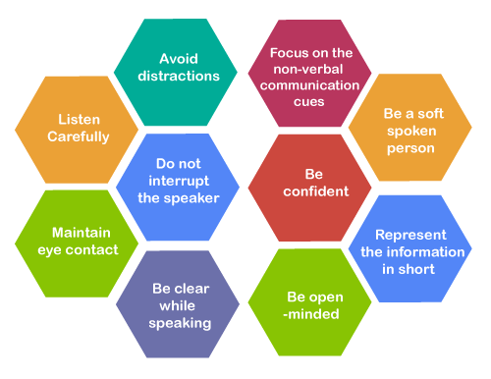
Verbal Communication Skills
Oral communication is the process of verbally transmitting information and ideas from one individual or group to another.
Oral communication can be either formal or informal.
Oral presentation in a professional environment generally fall into two categories:
1. Informative speaking
2. Persuasive speaking

Slide 6

Informative speaking
speech that is based on facts and figures
Informative speaking generally centers on talking about people, events, processes, places, or things. Informing an audience about one of these subjects without being persuasive is often a difficult task to complete.
- Analyze the audience
- Use appropriate language
- Explain the importance of the topic
- Express interest in the subject material
- Show, don’t tell
- Be specific
Notes:
For example, a speech informing an audience about growing peace lilies as houseplants might ultimately persuade the audience to buy and grow peace lilies. All speech has an effect that might enable individuals to self-persuade themselves. The line walked during an informative speech, as opposed to a persuasive speech, is to not make persuasion an explicit and obvious goal. An informative speech on peace lilies might cover both the advantages and disadvantages of these houseplants; a persuasive speech would take a firm position on the virtues of peace lilies.

Slide 7
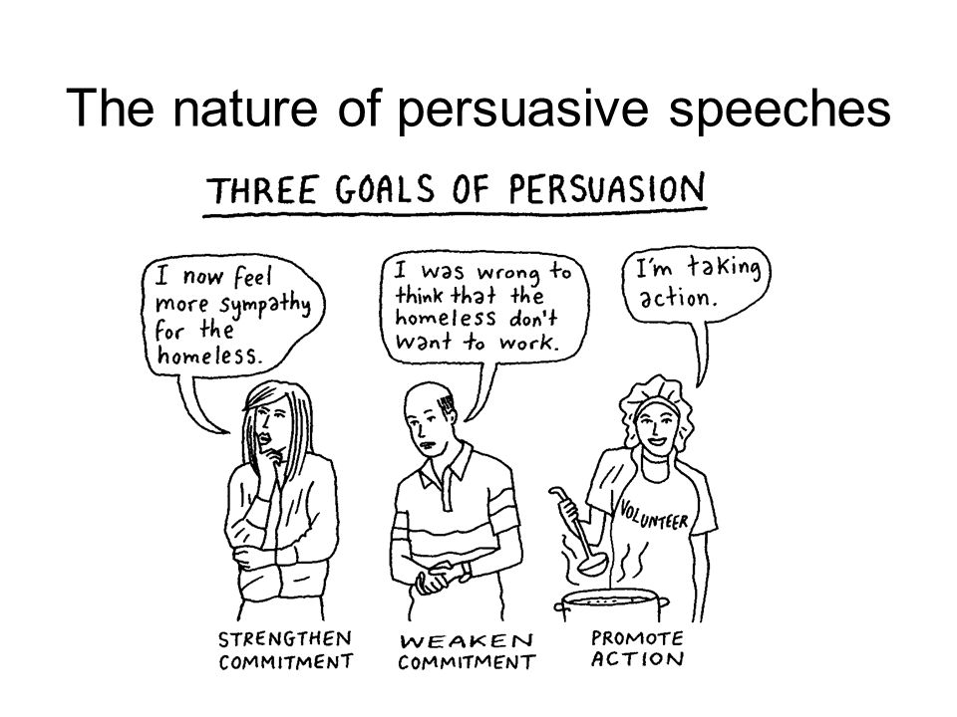
Persuasive speaking
convince someone to perform specific task
Persuasive speaking is the information that is intended to change or bolster a person’s attitude or course of action and is presented in written, audio, visual, or audiovisual form.
Persuasive speaking is very connected to the audience, as the speaker must, in a sense, meet the audience halfway.

Slide 8
Four Types of Speeches
Speeches can be categorized into four broad areas depending on the amount of preparation that is undertaken and depending upon the nature of the occasion.
The four types of speeches are:
Manuscript
Memorized
Extemporaneous
impromptu
Our aim is to acquaint you with these four different modes of delivery, to provide suggestions for when you are asked to make impromptu remarks, and then to focus most your time on the preparation, practice, and presentation of extemporaneous speeches.

Slide 9
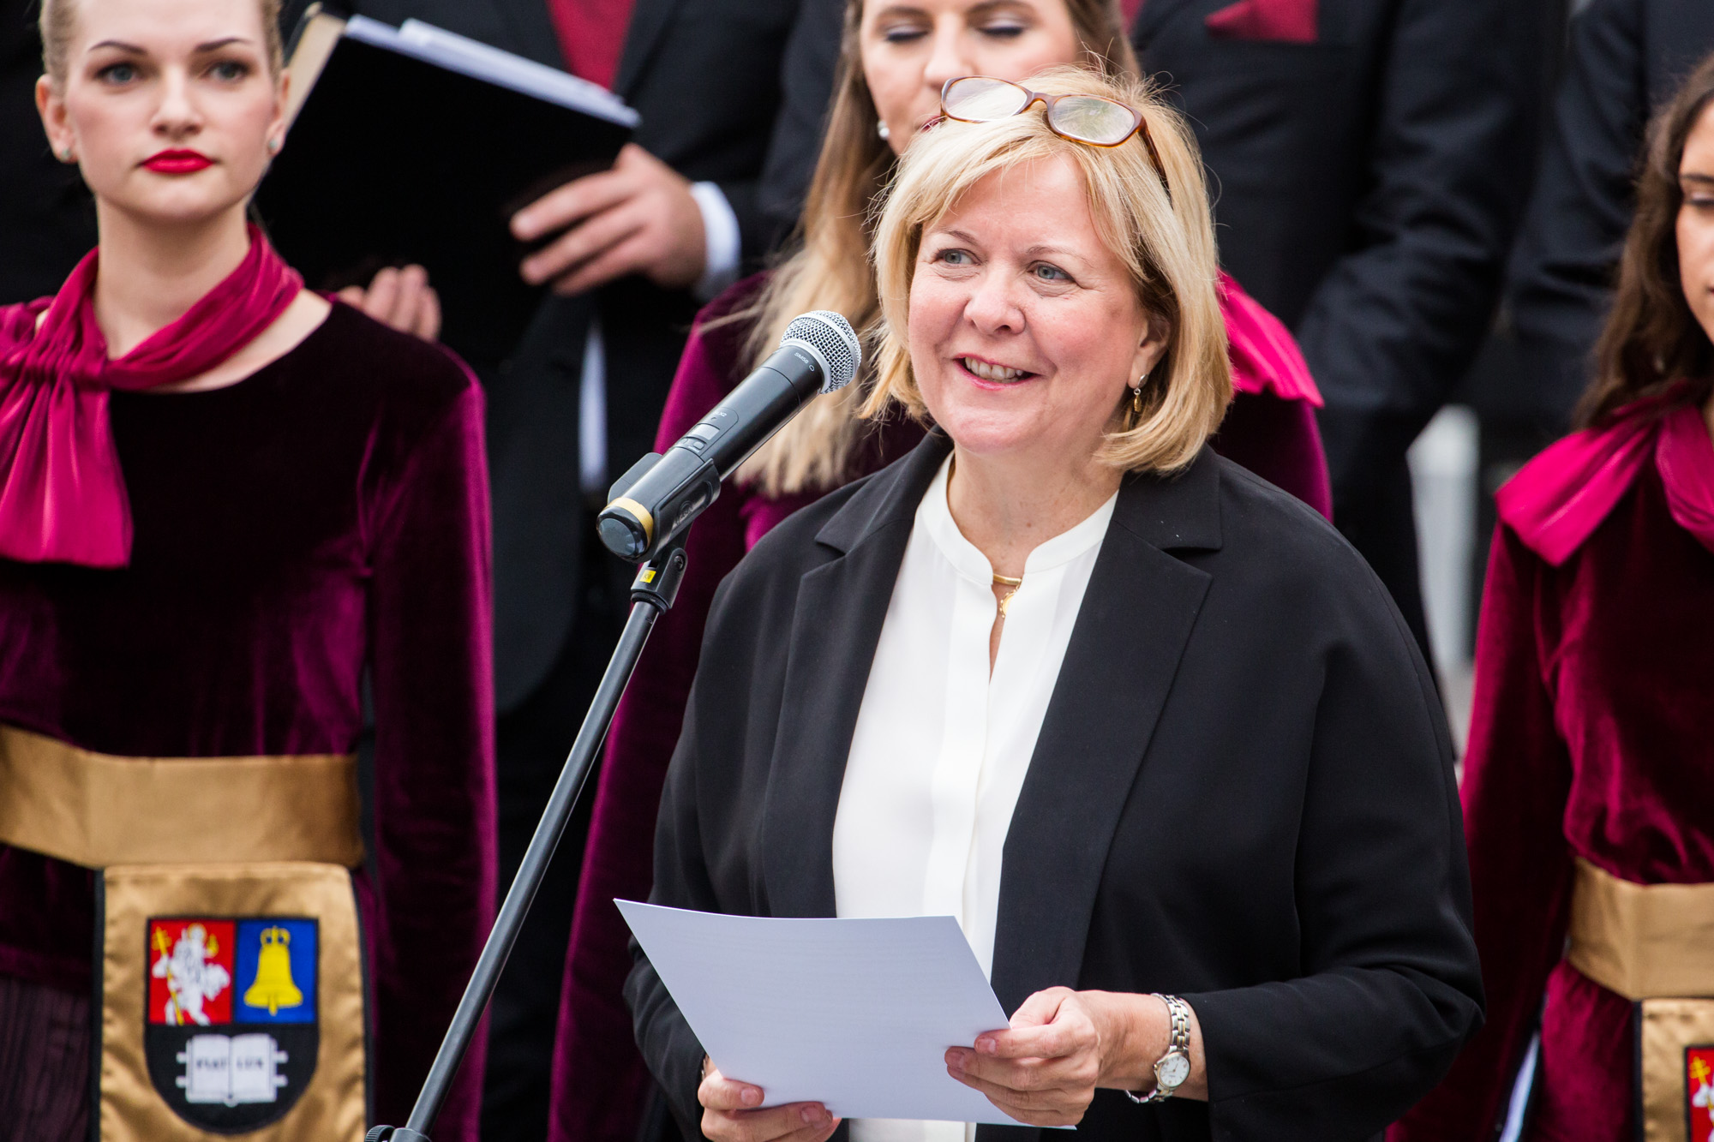
Manuscript Speech
This is when a speaker reads a pre-written speech word by word to an audience. It is when an already prepared script is read verbatim. The speaker makes the entire speech by referring to the printed document, or as seen on the teleprompter.

Slide 10
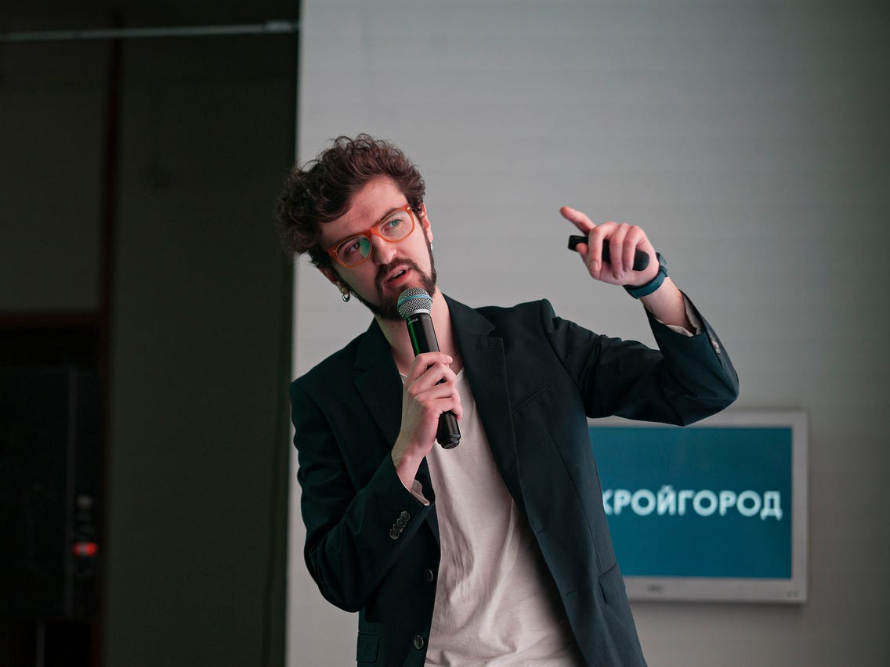
Memorized speech
It is the act of memorizing the information in a speech and presenting it without using notes. There is a benefit to delivering a speech this way. It doesn't require the speaker to carry note cards around the stage. ... Because you memorized the speech, you may speak in a very one-tone voice.

Slide 11

Extemporaneous Speak
Extemporaneous speech: A well-prepared speech that relies on research, clear organization, and practiced delivery, but is neither read nor memorized. What is an Extemporaneous Speech? The word extemporaneous means “without planning” and is considered a synonym for the word impromptu.
Notes:
Extemporaneous Speaking is a speech delivery style/speaking style, and a term that identifies a specific forensic competition

Slide 12

Impromptu speech
An impromptu speech is given with little or no preparation, yet almost always with some advance knowledge on the topic.

